Slide 1
Malaria Detection
Srikant Kumar Kalaputapu

Slide 2
Problem Definition
Traditional diagnosis procedures for the disease Malaria are tedious, time consuming and require experienced professionals.
Human error adversely impacts diagnosis and leads to fatalities.
An automated system to help with early and accurate detection of malaria can save more lives with better accuracy than manual diagnosis.
Malaria is one of the world’s deadliest diseases caused by the Plasmodium parasites that enter human red blood cells via mosquito bites.

Slide 3
Objectives
We need to create an efficient computer vision model to detect malaria
The model should take in an image of a red blood cell and determine if it's infected with the malaria parasite (plasmodium)
These cells will be classified as parasitized or uninfected
Parasitized cells contain the Plasmodium parasite (have Malaria)
Uninfected cells do not contain the parasite (no Malaria)

Slide 4
Data Description
There are a total of 24,958 train and 2,600 test images (colored) that we have taken from microscopic images of red blood cells. These images are labeled as Parasitized (value of 1) or Uninfected (value of 0) as described previously
Images are resized to 64 x 64 pixels
Each pixel has 3 values for RGB, with values from 0 to 255 normalized to a float32 number between 0 and 1
Approximately half of the train images and test images are labeled as parasitized

Slide 5
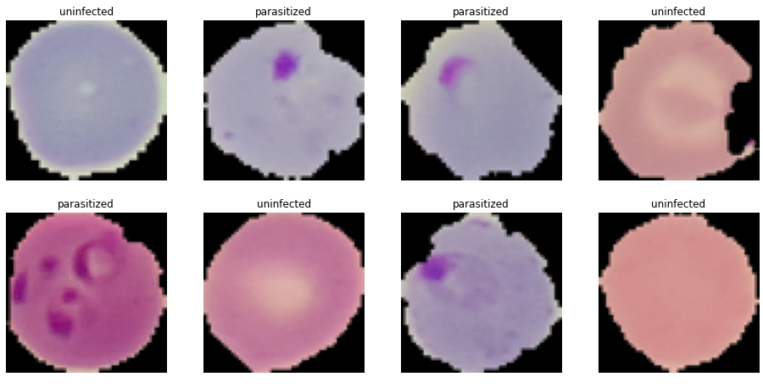
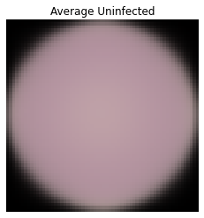
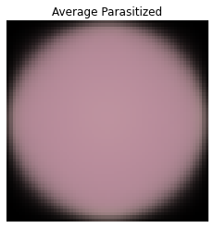
Data Exploration
Parasitized cells contain dark purple/red splotches
The ‘average’ images indicate higher values for Green and Blue (darker pink) in parasitized cell images

Slide 6
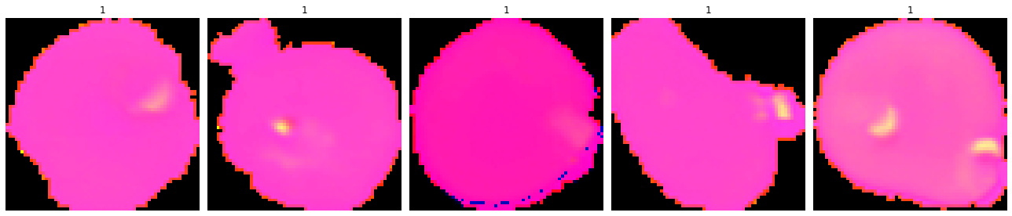
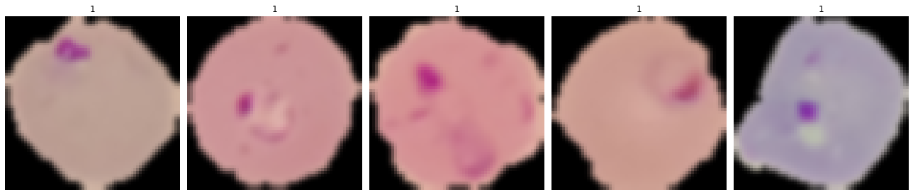
Data Exploration (cont.)
RGB to HSV Conversion to reduce the effect of light
Gaussian Blurring to reduce image noise
Notes:
RGB is affected by lighting, so converting to HSV (Hue, Saturation, Value).
Gaussiun blurring is used to reduce the size of the image and reduce image noise.

Slide 7
Proposed Model Solution
Basic Convolutional Neural Network (CNN) with convolution layers, max pooling layers, ReLU activation functions
Basic CNN with extra layers
CNN with LeakyReLU and Batch Normalization
CNN with Data Augmentation
Pre-trained model: VGG16
Notes:
Adding more layers will help you to extract more features.
ReLU: The derivative of the ReLU is 1 in the positive part, and 0 in the negative part.
LReLU: The derivative of the LReLU is 1 in the positive part, and is a small fraction in the negative part
Dropout is mostly a technique for regularization. It introduces noise into a neural network to force the neural network to learn to generalize well enough to deal with noise. (This is a big oversimplification, and dropout is really about a lot more than just robustness to noise)
Batch normalization is mostly a technique for improving optimization.
As a side effect, batch normalization happens to introduce some noise into the network, so it can regularize the model a little bit.

Slide 8
Measures of Success
Confusion Matrix, Classification Report, F1 Score, Recall, Precision and Accuracy
We want a model with:
High Accuracy (efficient model)
High Recall (less False Negatives)
High Precision (less False Positives)
High F1 score (combination of Recall and Precision)

Slide 9
Measures of Success (2)
False Positive: model evaluates a cell image to be parasitized when it is uninfected
Patients will undergo treatment even though they don’t have Malaria – wasting time and effort that could be used to save people who actually have Malaria
False Negative: model evaluates a cell image to be uninfected when it really is parasitized
Patients will not receive treatment with a negative diagnosis even though they have Malaria, resulting in possible death
We want this to be as low as possible to save lives

Slide 10
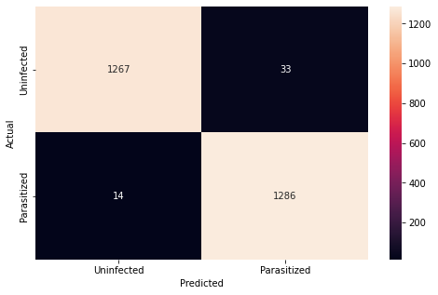
Final Model Solution
precision recall f1-score support 0 0.99 0.97 0.98 1300 1 0.97 0.99 0.98 1300 accuracy 0.98 2600 macro avg 0.98 0.98 0.98 2600 weighted avg 0.98 0.98 0.98 2600
precision recall f1-score support
0 0.99 0.97 0.98 1300
1 0.97 0.99 0.98 1300
accuracy 0.98 2600
macro avg 0.98 0.98 0.98 2600
weighted avg 0.98 0.98 0.98 2600
The basic CNN with extra layers had the best performance out of all the models tested
This model had the least number of False Negatives (high recall)
High accuracy, F1 score and precision.
Training and Validation accuracy follow similar trends

Slide 11
Proposed Business Solution
The CNN with extra layers model should be trained with a higher number of cell images of better quality.
The CNN should be made accessible for physicians and lab technicians who collect the Red Blood Cell images so they can diagnosis patients quickly
Promote the use of cloud computing for ease of access to and performance of neural networks
Need to educate technicians and physicians on how to interact / use the CNN
Notes:
More data to train results in better generalizations in evaluations of the NN. Need to be careful since too much data can result in overfitting.
This is bad as we don’t want noise of the training data to be learned as important features of the model.

Slide 12
Executing Business Solution
The trained model should be easily available via cloud solutions (Google Colab, AWS etc.) so that physicians/lab techs can evaluate red blood cell images on the fly
Create a user-friendly application to interact with the CNN to reduce the need to train technicians and physicians
Educate physicians and technicians on the benefits of said model and to get feedback to create better CNNs in the future

Slide 13
Executive Summary
The CNN model can evaluate if a red blood cell image contains the Malaria Parasite plasmodium.
This model is an automated process with high degree of accuracy
Traditional diagnosis procedures for the disease Malaria are tedious, time consuming and require experienced professionals.
Human error adversely impacts diagnosis and leads to fatalities.
The CNN model is an automated model than can detect the presence of Malaria with high accuracy and reduced number of false negatives
Having the model be accessible to technicians and physicians will allow for faster, more accurate diagnosis resulting in more people getting treatment faster – an increased survival chance

Slide 14
Risks and Challenges
Massive amounts of high quality data are required to train neural networks
Neural Networks take a great deal of computational power to train - power required grows exponentially - this effects ease of access
Neural Networks have been around for decades however media coverage and awareness is sporadic
Neural Networks have a “black box” nature – we don’t know how or why the NN came out with certain decisions. Context is missing for the decision making and that can lead to lack of trust of the networks.
Notes:
By a long time – 1944, however limitations in computational power and lack of large data sets prevented the implementation

Slide 15
Thank you

Slide 16
Appendix
https://builtin.com/data-science/disadvantages-neural-networks

Slide 17
Model comparison
Model | Accuracy | F1 Score | Recall (FN) | Precision (FP)
Basic CNN | .984 | .98 | 16 | 25
CNN with extra layers | .981 | .98 | 14 | 33
CNN with LeakyReLU and BatchNormalization | .979 | .98 | 33 | 21
CNN with Data Augmentation | .956 | .95 | 105 | 9
Pretrained VGG16 model | .941 | .94 | 58 | 94

Slide 18
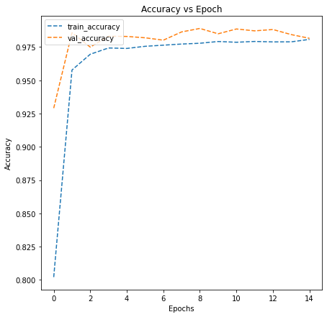
Validation vs Training accuracy

